Slide 1
Public Key Cryptography Dr. Arshad Farhad

Slide 2
RSA
by Rivest, Shamir & Adleman of MIT in 1977
best known & widely used public-key scheme
uses large integers (eg. 1024 bits)
Notes:
2
RSA is the best known, and by far the most widely used general public key encryption algorithm.
based on exponentiation in a finite (Galois) field over integers modulo a prime
nb. exponentiation takes O((log n)³) operations (easy)
uses large integers (eg. 1024 bits)
security due to cost of factoring large numbers
nb. factorization takes O(e ^{log n log log n}) operations (hard)

Slide 3
RSA in the “Real World”
Part of many standards: PKCS, ITU X.509, ANSI X9.31, IEEE P1363
Used by: SSL, PEM, PGP, Entrust, …
Notes:
It defines, how to generate pair of keys.

Slide 4
RSA Key Setup
each user generates a public/private key pair by:
selecting two large primes at random - p, q
computing their system modulus N=p.q
note ø(N)=(p-1)(q-1)
selecting at random the encryption key e
where 1<e<ø(N), gcd(e,ø(N))=1
solve following equation to find decryption key d
e.d=1 mod ø(N) and 0≤d≤N
publish their public encryption key: KU={e,N}
keep secret private decryption key: KR={d,p,q}
Notes:
4
This key setup is done once (rarely) when a user establishes (or replaces) their public key. The exponent e is usually fairly small, just must be relatively prime to ø(N). Need to compute its inverse to find d. It is critically important that the private key KR={d,p,q} is kept secret, since if any part becomes known, the system can be broken. Note that different users will have different moduli N.
Phi N – Euler totient
e = public key
GCD =
e.g., 20 = (divisor are) 1, 2, 4, 5, 10, 20
e.g., 11 = 1, 11 (called prime numbers)
GCD is 1, which is common in both.
For example, 20 = N, e= 11 GCD is 1, they are relative prime to each other
Therefore, e should be greater than 1 and less than pi N.
d is private key,

Slide 5
RSA Use
to encrypt a message M the sender:
obtains public key of recipient KU={e,N}
computes: C=Me mod N, where 0≤M<N
to decrypt the ciphertext C the owner:
uses their private key KR={d,p,q}
computes: M=C^{d} mod N
note that the message M must be smaller than the modulus N (block if needed)

Slide 6
Prime Numbers
prime numbers only have divisors of 1 and self
they cannot be written as a product of other numbers
note: 1 is prime, but is generally not of interest
eg. 2,3,5,7 are prime, 4,6,8,9,10 are not
prime numbers are central to number theory
list of prime number less than 200 is:
2 3 5 7 11 13 17 19 23 29 31 37 41 43 47 53 59 61 67 71 73 79 83 89 97 101 103 107 109 113 127 131 137 139 149 151 157 163 167 173 179 181 191 193 197 199

Slide 7
Prime Factorisation
to factor a number n is to write it as a product of other numbers: n=a × b × c
note that factoring a number is relatively hard compared to multiplying the factors together to generate the number
the prime factorisation of a number n is when its written as a product of primes
eg. 91=7×13 ; 3600=2⁴×3²×5²
Notes:
7

Slide 8
Relatively Prime Numbers & GCD
two numbers a, b are relatively prime if have no common divisors apart from 1
eg. 8 & 15 are relatively prime since factors of 8 are 1,2,4,8 and of 15 are 1,3,5,15 and 1 is the only common factor
conversely can determine the greatest common divisor by comparing their prime factorizations and using least powers
eg. 300=2²×3¹×5² 18=2¹×3² hence GCD(18,300)=2¹×3¹×5⁰=6

Slide 9
Fermat's Theorem
a^{p-1} mod p = 1
where p is prime and gcd(a,p)=1
also known as Fermat’s Little Theorem
useful in public key and primality testing

Slide 10
Euler Totient Function ø(n)
For a given positive integer n, how many smaller positive integers, relative to it, are prime?
when doing arithmetic modulo n
complete set of residues is: 0..n-1
reduced set of residues is those numbers (residues) which are relatively prime to n
eg for n=10,
complete set of residues is {0,1,2,3,4,5,6,7,8,9}
reduced set of residues is {1,3,7,9}
number of elements in reduced set of residues is called the Euler Totient Function ø(n)

Slide 11
Euler Totient Function ø(n)
to compute ø(n) need to count number of elements to be excluded
in general need prime factorization, but
for p (p prime) ø(p) = p-1
for p.q (p,q prime) ø(p.q) = (p-1)(q-1)
eg.
ø(37) = 36
ø(21) = (3–1)×(7–1) = 2×6 = 12

Slide 12
Euler's Theorem
a generalisation of Fermat's Theorem
a^{ø(n)}mod N = 1
where gcd(a,N)=1
eg.
a=3;n=10; ø(10)=4;
hence 3⁴ = 81 = 1 mod 10
a=2;n=11; ø(11)=10;
hence 2¹⁰ = 1024 = 1 mod 11

Slide 13
Why RSA Works
because of Euler's Theorem:
a^{ø(n)}mod N = 1
where gcd(a,N)=1
in RSA have:
N=p.q
ø(N)=(p-1)(q-1)
carefully chosen e & d to be inverses mod ø(N)
hence e.d=1+k.ø(N) for some k
hence : C^{d} = (Me)^{d} = M^{1+k.ø(N)} = M¹.M^{ø(N)} = M¹.(1)= M mod N
Notes:
13

Slide 14
RSA Example
Select primes: p=17 & q=11
Compute n = pq =17×11=187
Compute ø(n)=(p–1)(q-1)=16×10=160
Select e : gcd(e,160)=1; choose e=7
Determine d: de=1 mod 160 and d < 160 Value is d=23 since 23×7=161
Publish public key KU={7,187}
Keep secret private key KR={23,17,11}
Notes:
14

Slide 15
RSA Example cont
sample RSA encryption/decryption is:
given message M = 88 (nb. 88<187)
encryption:
C = 88⁷ mod 187 = 11
decryption:
M = 11²³ mod 187 = 88
Encryption
Decryption
Ciphertext
Plaintext
7
11
23
Plaintext
88
88
mod
187
=
11
11
mod
187
=
88
88
KU
=
7
,
187
KR
=
23
,
187
Example of RSA Algorithm
Notes:
15

Slide 16
Euclidean division
Given two integers a and b, with b ≠ 0, there exist unique integers q and r such that
a = bq + r
and
0 ≤ r < |b|,
where |b| denotes the absolute value of b.
The four integers that appear in this theorem have been given names: a is called the dividend, b is called the divisor, q is called the quotient and r is called the remainder.

Slide 17
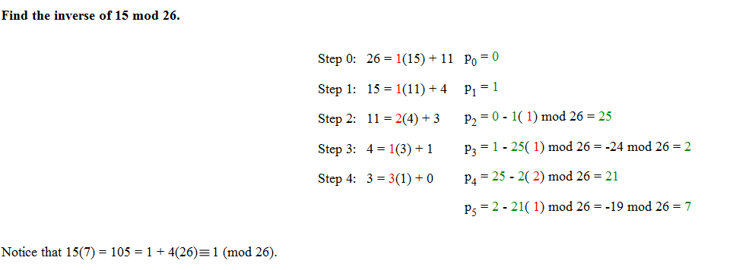
Extended Euclidean Example
Find the inverse of 15 mod 26.
15 (7) = 105 = 1 + 4(26) = 1 mode 26.
http://www-math.ucdenver.edu/~wcherowi/courses/m5410/exeucalg.html

Slide 18
Exponentiation
can use the Square and Multiply Algorithm
a fast, efficient algorithm for exponentiation
concept is based on repeatedly squaring base and multiplying in the ones that are needed to compute the result
look at binary representation of exponent
only takes O(log₂ n) multiples for number n

Slide 19

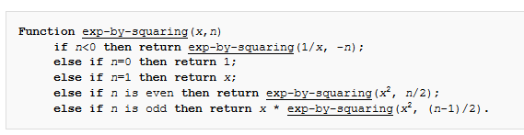
Sqaure and multiply

Slide 20
RSA Key Generation
users of RSA must:
determine two primes at random - p, q
select either e or d and compute the other
primes p,q must not be easily derived from modulus N=p.q
means must be sufficiently large
typically guess and use probabilistic test
exponents e, d are inverses, so use Inverse algorithms to compute the other
Notes:
20

Slide 21
RSA Security
approaches to attacking RSA:
brute force key search (infeasible given size of numbers)
mathematical attacks (based on difficulty of computing ø(N), by factoring modulus N)
factor N=p.q, hence find ø(N) and then d
determine ø(N) directly and find d
find d directly

Slide 22
Practice
Perform encryption and decryption using RSA algorithm, for the following:
p = 3; q = 11, e = 7; M = 5
p = 5; q = 11, e = 3; M = 9
In a public-key system using RSA, you intercept the ciphertext C = 10 sent to a user whose public key is e = 5, n = 35. What is the plaintext M?
22

